Slide 1
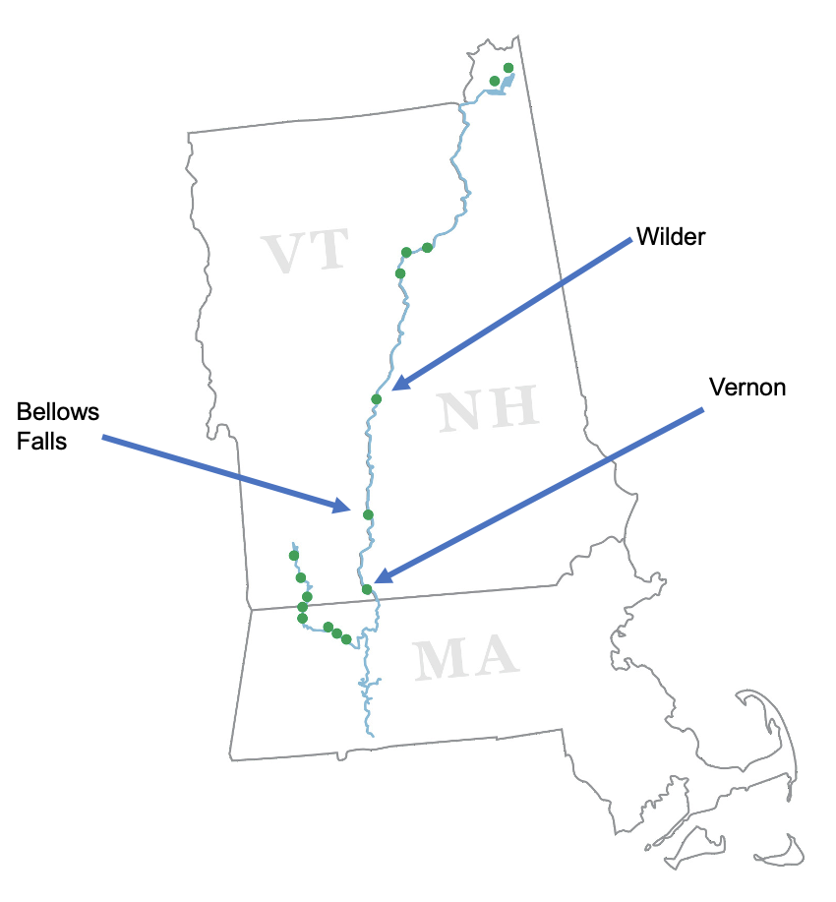
Connecticut River
Deerfield River
GRH Facilities

